Slide 1
AutoDo
Project analysis and documentation.
Sara Fernández

Slide 2
Contents
0. Introduction
Project overview
Use case diagram
Event storming
Sequence diagrams and Data flows
Data model
Architecture overview
Work packages and deliverables
Conclusion

Slide 3
Introduction
Brief Overview
AutoDo seeks to automate the task of reviewing job offers and finding appropriate matches among o2Do employees and freelancers. Using forward-thinking strategies and AI algorithms, AutoDo simplifies this process, saving time and resources by reducing paperwork and administrative tasks.
Purpose of the document
This document aims to provide stakeholders and team members, including managers, o2Do commercials and developers, with a comprehensive understanding of the project. It outlines the project’s goals, objectives and design considerations.
Throughout the document, descriptions of key components such as use case diagrams, data flows and architecture overviews are provided to clarify and align the business and technical parties on the system implementation.

Slide 4
Glossary
RFP (Request for Proposal): job description issued by a client (organization or entity) seeking consultancy services. It outlines the requirements, specifications, and skills required for the consultancy project.
Proposal: formal response to an RFP submitted by a supplier (o2Do). It typically includes details about the candidate qualifications, approach to meeting the requirements outlined in the RFP, pricing, and other relevant information.
Profile: o2Do employee or freelancer who is considered for a job or position. They submit their resumes or profiles in response to o2Do’s job postings or o2Do’s newsletter. They may belong to the o2Net community. Note that a single individual may correspond to more than one profile. For example, an o2Do employee could work as both a data engineer and a data scientist.
Contract: agreement between the client and o2Do that outlines the terms and conditions of their relationship or transaction. Contracts include timelines and payment terms, among other. A contract is created after the client accepts a proposal.
Client: company that seeks IT consultancy services.
o2Do Commercial: responsible for facilitating communication between clients and profiles, and for ensuring guidance and support to both thorough the hiring process.

Slide 5
Project Overview
1.

Slide 6
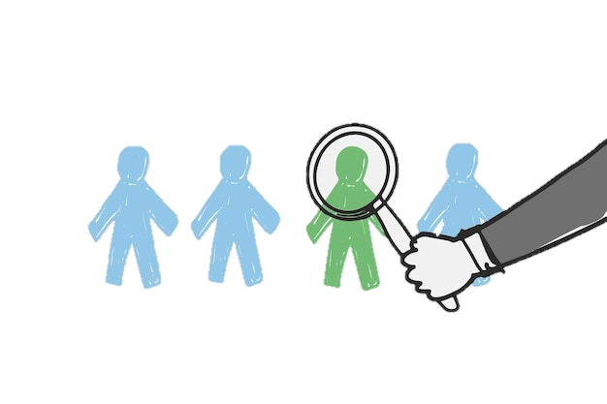
Project Goals
The goals of AutoDo include the following desired outcomes:
Improve efficiency in matching job offers with suitable candidates.
Improve quality of customer experience: strength customer relationship and build customer loyalty.
Reduce manual effort and administrative work associated with candidate selection.
Increase the speed of filling clients’ job vacancies.
Increase revenue through improved talent acquisition and strategic hires.

Slide 7
Goal metrics
Improve efficiency in matching job offers with suitable candidates.
Response rate: increase in the percentage of job offers responded to with proposals.
Proposal increase: increase of proposals submitted to clients.
Profile database growth: increase in the number of profiles stored in the database.
Contract generation: increase in the number of contracts generated as a result of successful matches.
Improve quality of customer experience: strength customer relationship and build customer loyalty.
Response time reduction: decrease in the average response time to customer requests.
Update frequency: increase in the frequency of updates provided to clients regarding their requests or their candidacy.
Reduce manual effort and administrative work associated with candidate selection.
Time savings: decrease in the time required to find a profile that matches a client’s request.
Automation efficiency: decrease in the number of tasks requiring manual intervention.
Increase the speed of filling clients’ job vacancies.
Early proposal submission: increase in the average number of days proposals are submitted before the RFP deadline.
Reduction in time to fill responses to RFPs.
Increase revenue through improved talent acquisition and strategic hires.
Sales growth: increase in contracts generated through automated matches.
Retention rate: increase in customer retention due to customer satisfaction.
Margin improvement: increase in profit margins from cost-effective talent acquisition and automated hiring practices.

Slide 8
High-level deliverables
Develop a scraping algorithm capable of extracting job offers from emails, whether they are attached files (image or PDF), included in the body text, or provided as links to the recruiter’s platform.
Classify the offers, i.e. the RFPs, by relevance, and store them in a database.
Create a database containing profiles from both o2Do employees and freelancers of o2Net community. Ensure that o2Do commercials can easily add and update new profiles.
Design, develop and implement an automated matching algorithm to efficiently identify suitable candidates for job offers.
Create a proposals database containing validated matches. O2Do commercials must be able to update the proposals’ status at any time.
Store the contracts and their details.
Develop a program that groups new and relevant offers and sends them out in a periodic newsletter format.
Integrate the AutoDo system into o2Do’s HR recruitment process.

Slide 9
System’s Users (Actors)
Who and how they will interact with the AutoDo system.
o2Do commercials
They receive job offers.
They are responsible for reviewing candidate profiles and validating matches.
They communicate with potential candidates.
They manage new clients and new profiles.
They negotiate the contract terms.
They send the newsletter.
Profiles
They seek job opportunities.
Through the o2Do commercial, they update their profiles, view job offers and apply for positions that match their skills and experience.
They agree or not to send their candidacy for a match.
They receive the newsletter.
Clients*
They submit job opportunities. They are represented by the Contact Person.
They may interact with the system to access and add reports related to recruitment activities, e.g. feedback after an interview.
They take part of the contract negotiation.
IT support
Responsible for providing technical support and troubleshooting.
Assist with system access.
Update features and add new ones.
*At first, profiles only indirectly interact with the AutoDo platform.
*At first, clients only indirectly interact with the AutoDo platform.

Slide 10

Product Overview
The AutoDo system is a recruitment solution designed to facilitate the process of matching job offers with suitable candidates. It uses advanced algorithms to develop reduce manual effort and speed up the process of finding assignments for o2Do employees and partners, ultimately increasing o2Do’s revenues.
Key Features
Automated RFP classification: read and select relevant RFPs for o2Do.
Automated matching algorithm: find the best correspondence between RFP and profile.
Reporting and analytics in dashboard format: understand how and where to improve the company sales.
Quality: increase your stakeholders’ satisfaction.
Data security and protection.

Slide 11
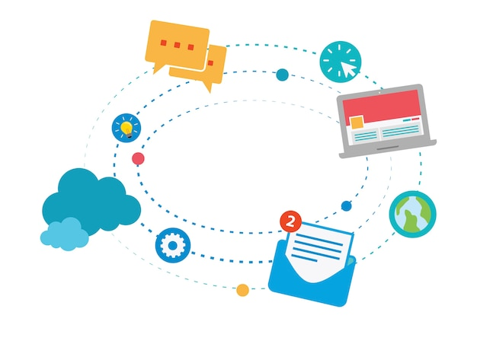
Product Requirements
User authentication
The system should have access to multiple sources of job offers: emails, job boards and client’s platforms.
O2do Commercial can access the candidate profiles and update them, including their personal information, skills, experience, preferences and availability.
AutoDo must automatically classify the RFPs based on predefined relevance criteria and keywords.
It should implement an automated matching algorithm that analyses the pertinent RFPs and candidate profiles to identify and output matches (proposals).
The system should either provide enough data to build a dashboard containing track recruitment metrics, or a dynamic dashboard to generate reports and visualize the whole process performance.
The system should protect sensitive information and personal data.

Slide 12

Risks
Risk | Risk type | Impact | Probability | Mitigation measures
Quality of matches | Operational | Client dissatisfaction |  | Implement regular quality checks and ask feedback from clients.
Misclassification of RFPs relevance | Operational | Missed opportunities |  | Review keywords and regularly update guidelines to assign RFP relevance.
User adoption | Strategic | Time and resource investment loss |  | Conduct user training to promote system understanding and usage.
Delays between AutoDo system processing and o2Do commercials | Operational | Missed opportunities |  | Fix clear response times and implement automated notifications.
Data security incidents | Compliance | Loss of trust and penalties |  | Implement user authentication to access the system and follow data security protocols.
The risk probability may be evaluated using the Delphi method.
The risk types are defined as follows:
Operational: risks associated with everyday operations and processes, like system malfunctions or errors in the algorithm.
Strategic: risks related to long-term decision-making, such as changes in market demand or competition. They impact the ability of the system to adapt to evolving client needs and business opportunities.
Compliance: risks associated with failing to meet legal and regulatory requirements, like data protection regulations.

Slide 13
Use Case Diagram
2.

Slide 14
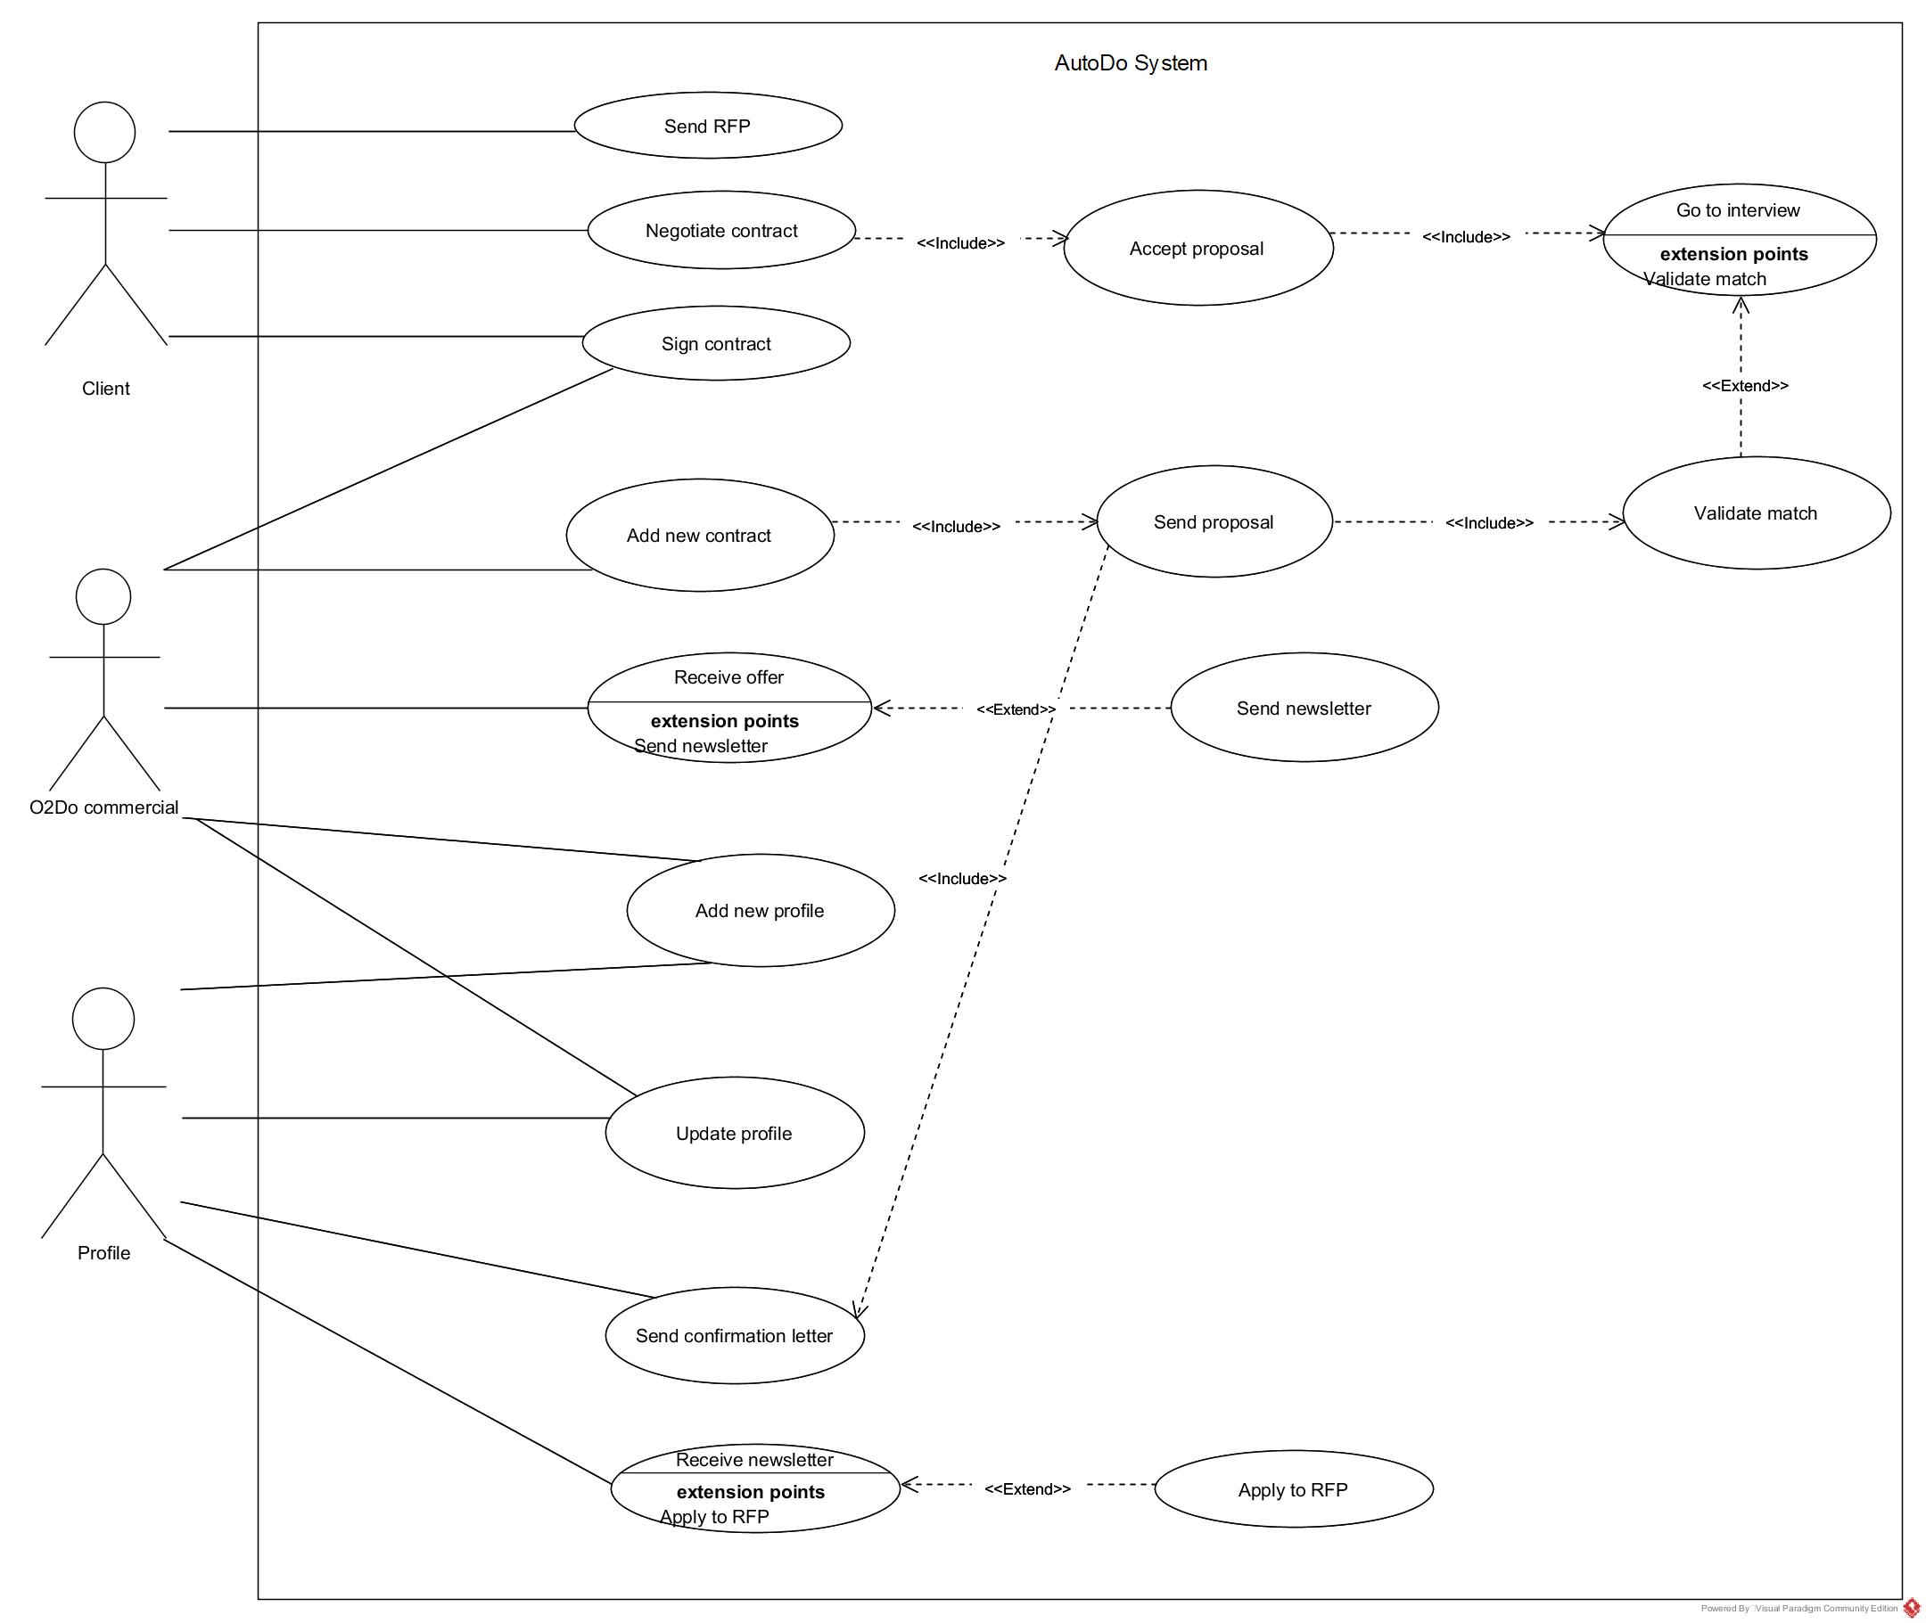
The use case diagram below summarizes how the actors interact with AutoDo.

Slide 15
Event Storming
3.

Slide 16
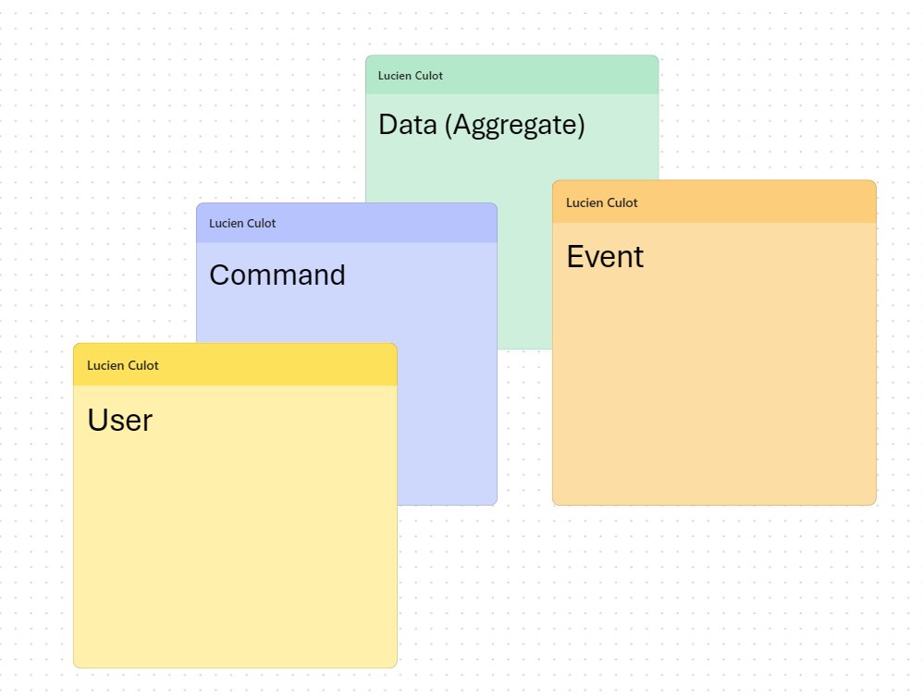
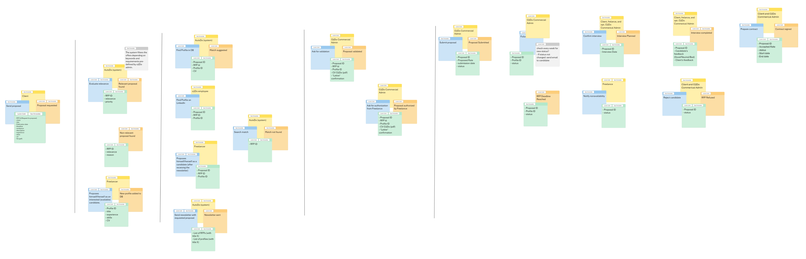
As a starting point, the collaborative event storming exercise allowed us to better understand the system behaviour. Together with stakeholders, we identified the flow of events and commands within the system, as well as key events and actions that trigger the system behaviour.
Legend
Link to the Event Storming board

Slide 17
Sequence Diagrams and Data Flows
4.

Slide 18
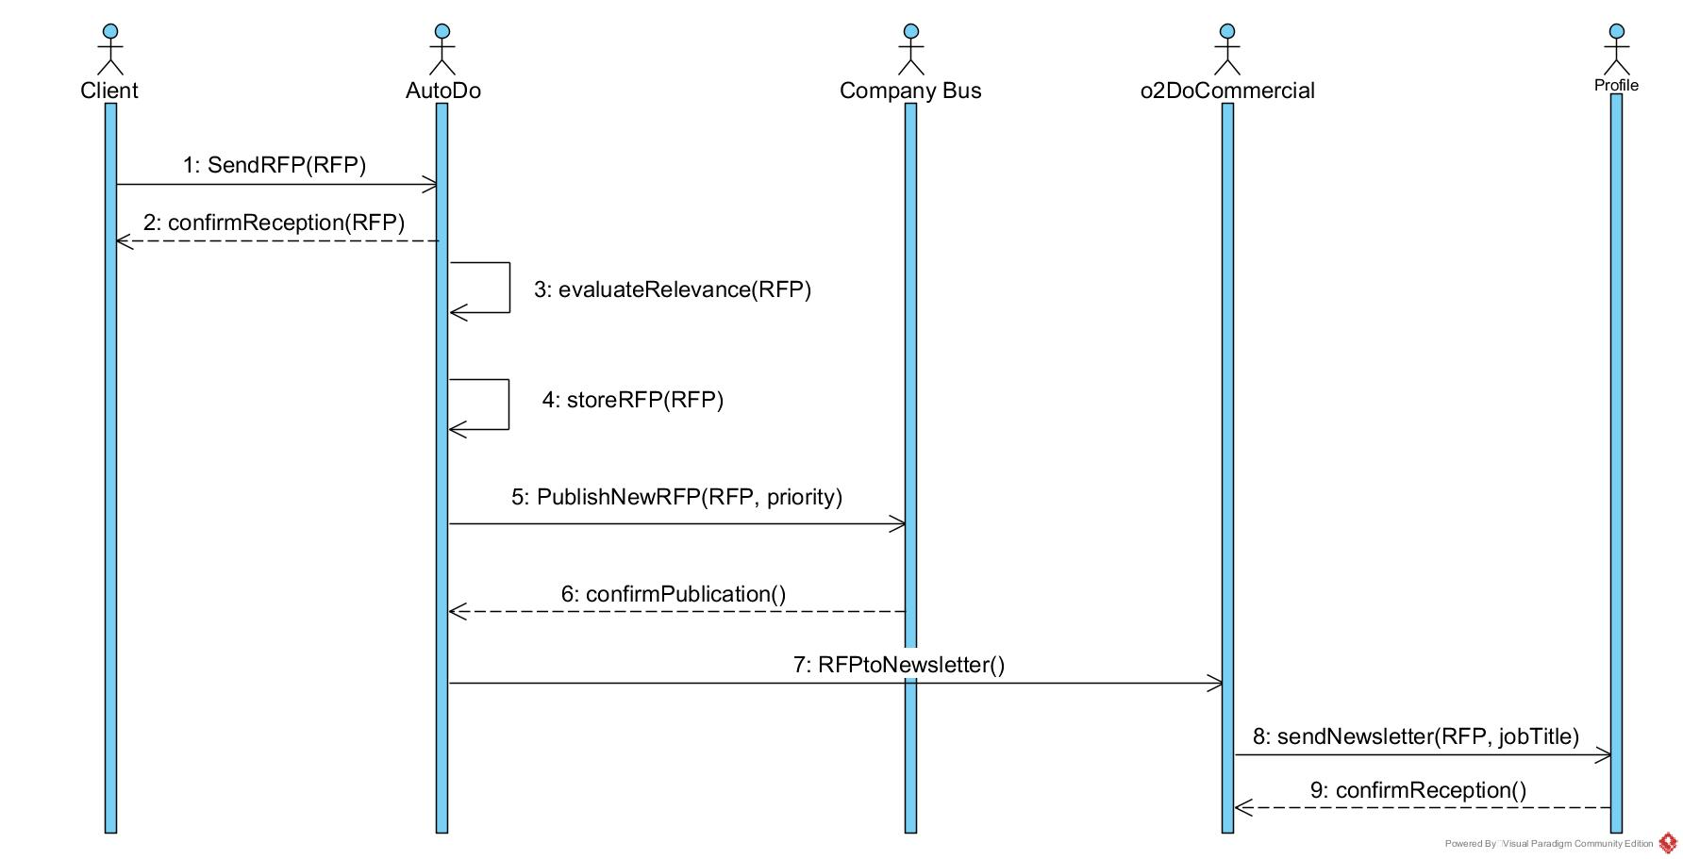
The sequence diagrams hereafter illustrate the dynamic interactions between different components within the AutoDo system. It provides a visual representation of the message flows and the sequence of actions in various scenarios.
1. RFP Reception

Slide 19
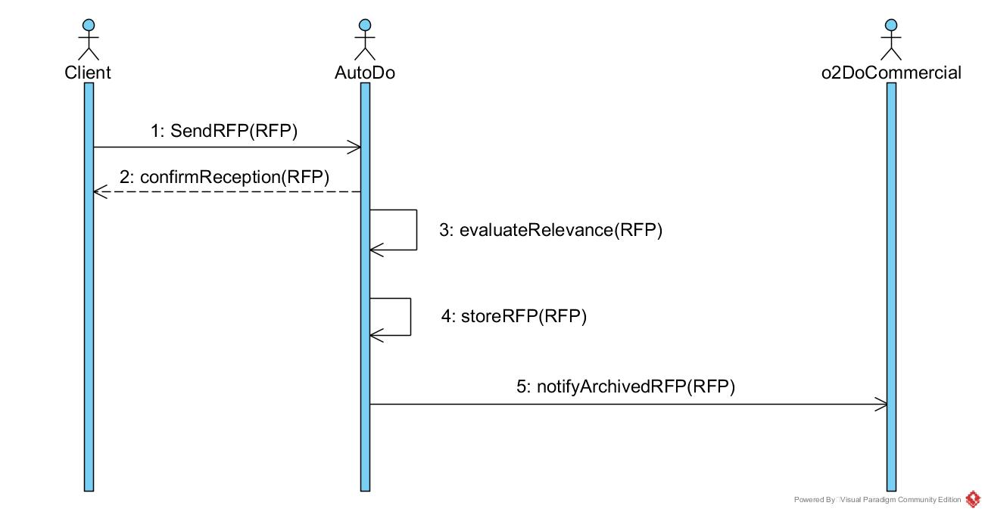
1.a. Reception of non-relevant RFP

Slide 20
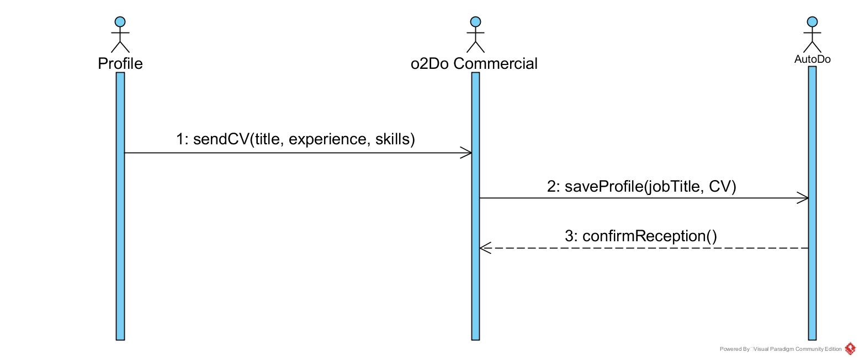
2. Profile Reception

Slide 21
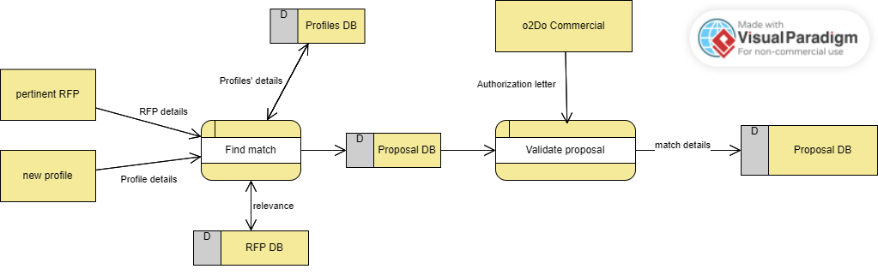
3. Matching algorithm: finding proposal
Legend
External Entity
Process
D
Data Store

Slide 22
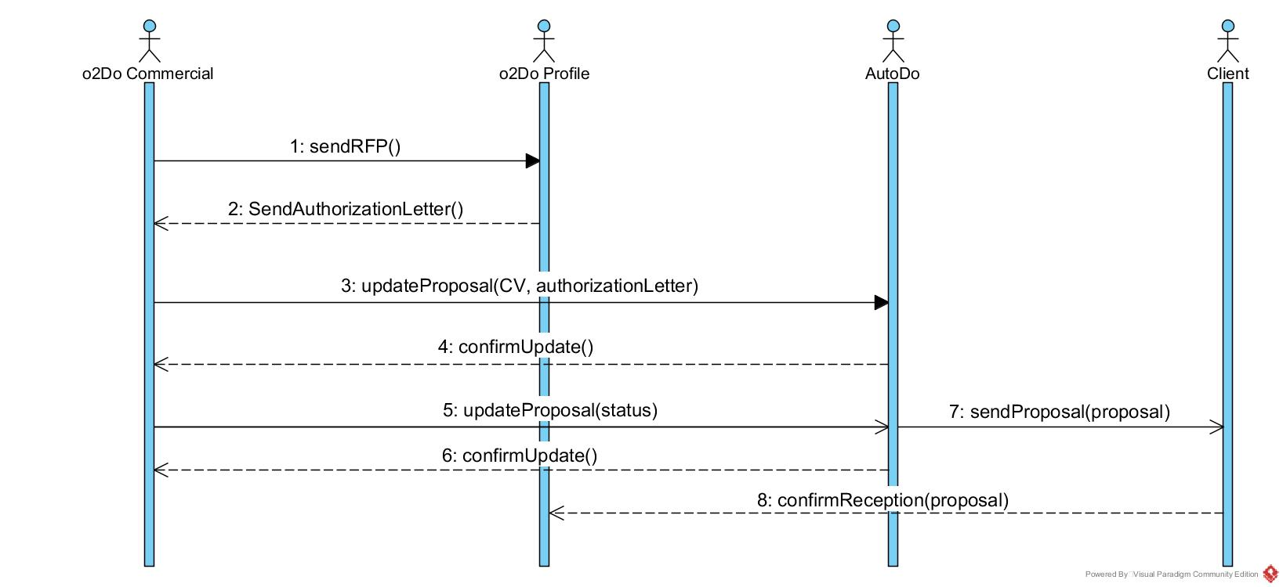
4. Sending proposal

Slide 23
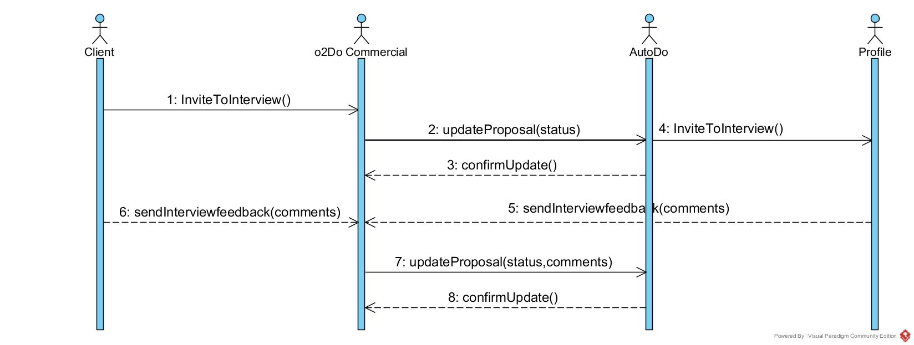
4.1. Proposal accepted

Slide 24
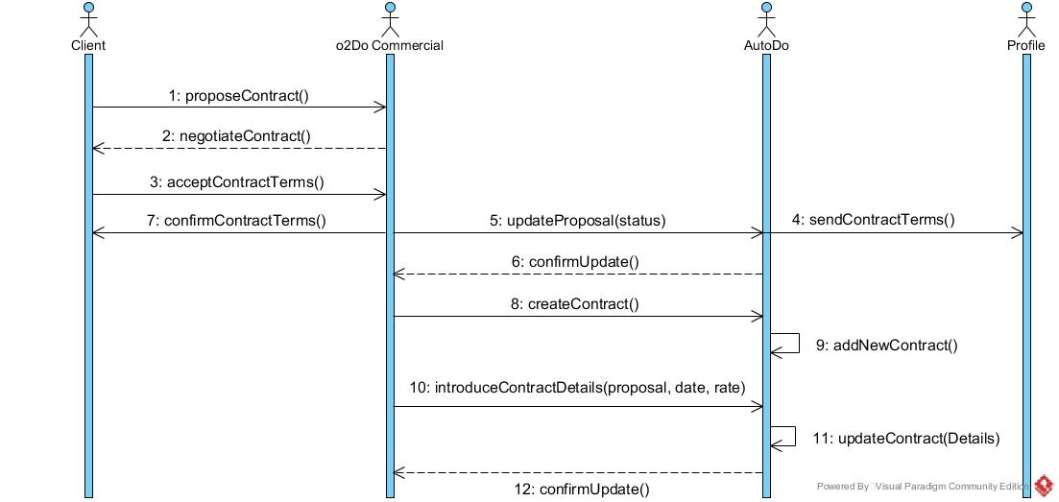
5. Sign Contract

Slide 25
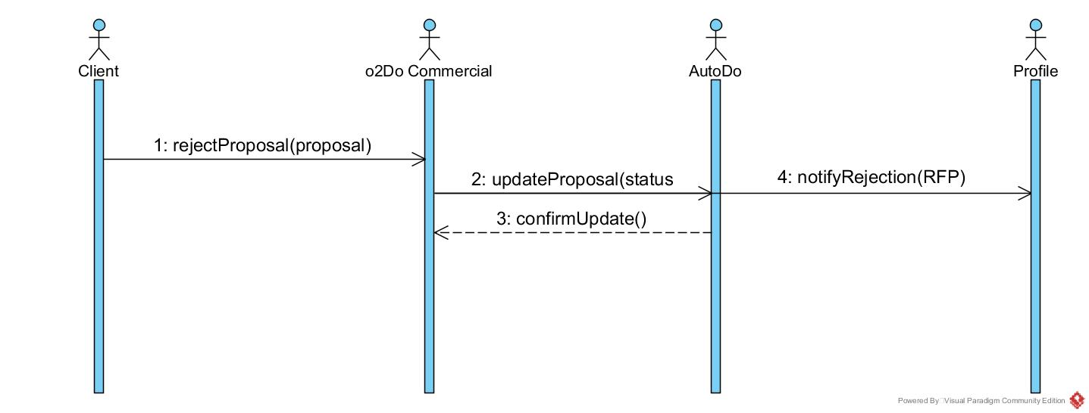
4.a. Proposal rejected

Slide 26
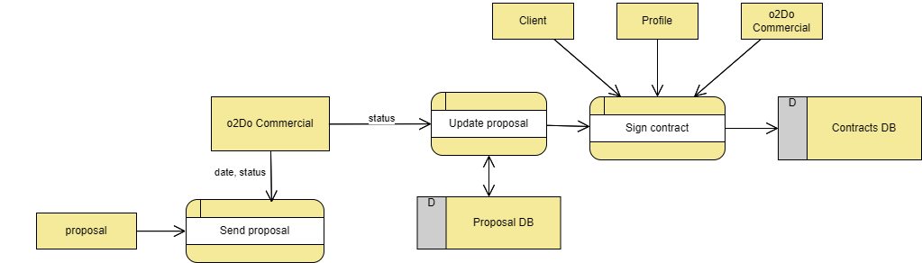
6. Tracking proposal
Legend
External Entity
Process
D
Data Store

Slide 27
Data Model
5.

Slide 28
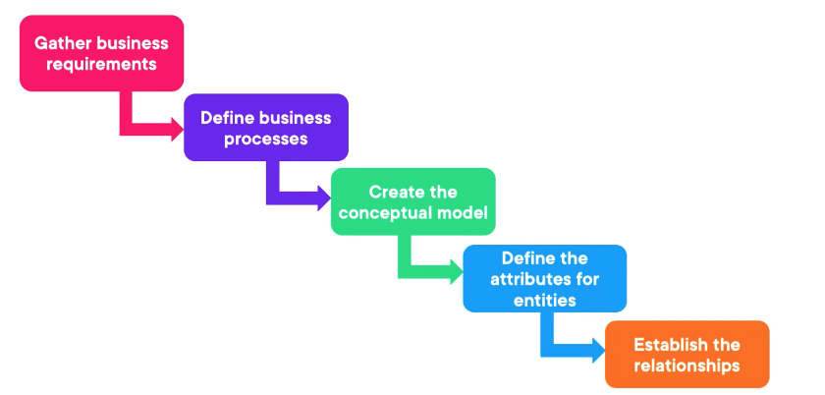
Types of Data Model
Conceptual
Logical
Physical
Precise, actual implementation
Normalization techniques; define attributes, primary and foreign keys…
Overall structure of business and data.
The purpose is to define the scope of the solution.
Steps to design a data model

Slide 29
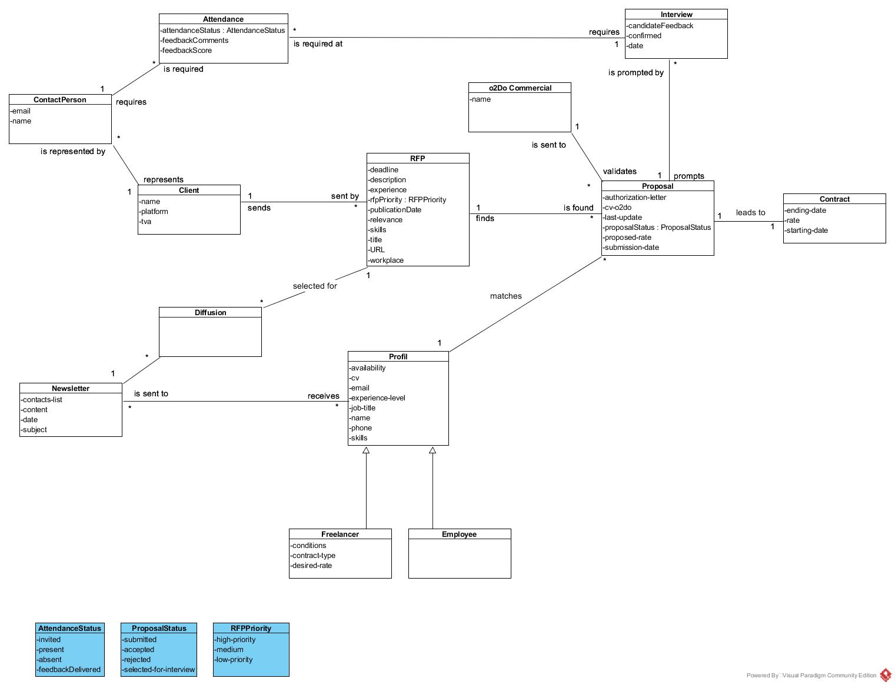
Data model
Notes:
Conceptual

Slide 30
Architecture Overview
6.

Slide 31







RFP id
Scrapper
RFP relevance
Title, skills, experience
newsletter
Client
admin-dpt@o2do.be
RFPs database
Find Match
Title, skills, experience
Profiles database
Proposal id
Client’s platform interface
Proposal id
Proposals database
o2Do commercial
Title, skills, experience, availability, CV
Legend
Proposal id, status
automation
Profil
user
o2Do commercial’s monitoring interface
database
browser
Contracts database

Slide 32
Work Packages and Deliverables
7.

Slide 33
2.1. Status update features
2. Proposal tracker
1.2. RFP classification
1.1. RFP database
1. Matching Algorithm
AutoDo
1.3. Match suggestion
3. Statistics dashboard
2.2. Contracts database
1.3.1. Identify profiles that correspond to RFP requirements
1.3.2. Display matches
3.1. Allow the export of proposal related data
3.2. Build dashboard
1.2.1. Output pertinent RFPs for newsletter
1.4. Profiles database
1.4.1 o2Net
1.4.2. LinkedIn*
*Out of scope

Slide 34
Conclusion
This document summarizes the goals, objectives, risks and characteristics of the AutoDo project. It also describes its key features and provides guidelines on user interaction with the product.
From a business analyst perspective, the inclusion of use case diagrams, sequence diagrams and the data model aim to align both business and technical stakeholders on definitions, needs, and design requirements.
The high-level system architecture illustrates the different components of the system and their interactions.
Finally, work packages and deliverables are briefly introduced. These are intended to evolve alongside business requirements and as product feasibility is defined.
The documentation will continue to evolve alongside the project, capturing updates and refinements as the product development progresses.
The next steps of the project include further refinement of work packages and deliverables to meet business requirements and technical feasibility.

